Slide 1
Fire Alarm Detection
Konkan Gyanpeeth College Of Engineering
TE - IT
Project By:
Pranav Salve (55)
Devang Shinde (61)
Sachin Tambe(68)
Pritam Turalkar(71)
Project Guide:
Prof: Kavita Yadav

Slide 2
Introduction
➢ What is IOT?
The word "Internet of Things" has two main parts; Internet being the backbone of connectivity, and Things meaning objects / devices . In a simple way to put it, You have "things" that sense and collect data and send it to the internet. In simple language, IoT converts a normal device into smart device.

Slide 3
Introduction to Fire Alarm
➢ Fire Alarm System is designed to alert us to an emergency so that we can take action to protect ourselves, staff and the general public.
➢ Fire alarms are found in Offices, Factories, and public buildings, they are a part of our everyday routine but are often overlooked until there is an emergency at which point, they might just save our lives.
➢ Whatever the method of detection is, if the alarm is triggered, sounders will operate to warn people in the building that there may be a fire and to evacuate.
➢ The fire alarm system may also incorporate a remote signal system which could then alert the fire brigade via a central station.
➢ So what is a fire alarm system, or fire detection system? In this article, we will have a look at the structure and types of the “Fire Alarm Systems”.

Slide 4
Objective
➢ A fire alarm system has a number of devices working together to detect and warn people through visual and audio appliances when smoke, fire, carbon monoxide or other emergencies are present.
➢ These alarms may be activated automatically from smoke detectors, and heat detectors or may also be activated via manual fire alarm activation devices such as manual call points or pull stations.
➢ Alarms can be either motorized bells or wall mountable sounders or horns. Fire alarm sounders can be set to certain frequencies and different tones including low, medium and high, depending on the country and manufacturer of the device.
➢ Most fire alarm systems in Europe sound like a siren with alternating frequencies. Fire alarm electronic devices are known as horns in the United States and Canada, and can be either continuous or set to different codes. Fire alarm warning devices can also be set to different volume levels.

Slide 5
Purpose And Scope
➢ Fire accidents can be controlled to a great extent in a places such as forests, colleges industries, homes, trains and some other public places
➢ Fire accidents leads to death of excess of people, by using this technique we can save those lifes easily
➢To detect the chain smokers(which are hazardous to health)
➢Preventing material damage
➢Preventing ecological damage4

Slide 6
Requirement Specification
Software
Hardware
➢ Windows 7 or up
➢ Arduino IDE
➢ Breadboard
➢ Wires
➢ ARDUINO R3
➢ Piezo Buzzer
➢ Resistor
➢ Gas Sensor
➢ Temperature Sensor
➢ Led

Slide 7
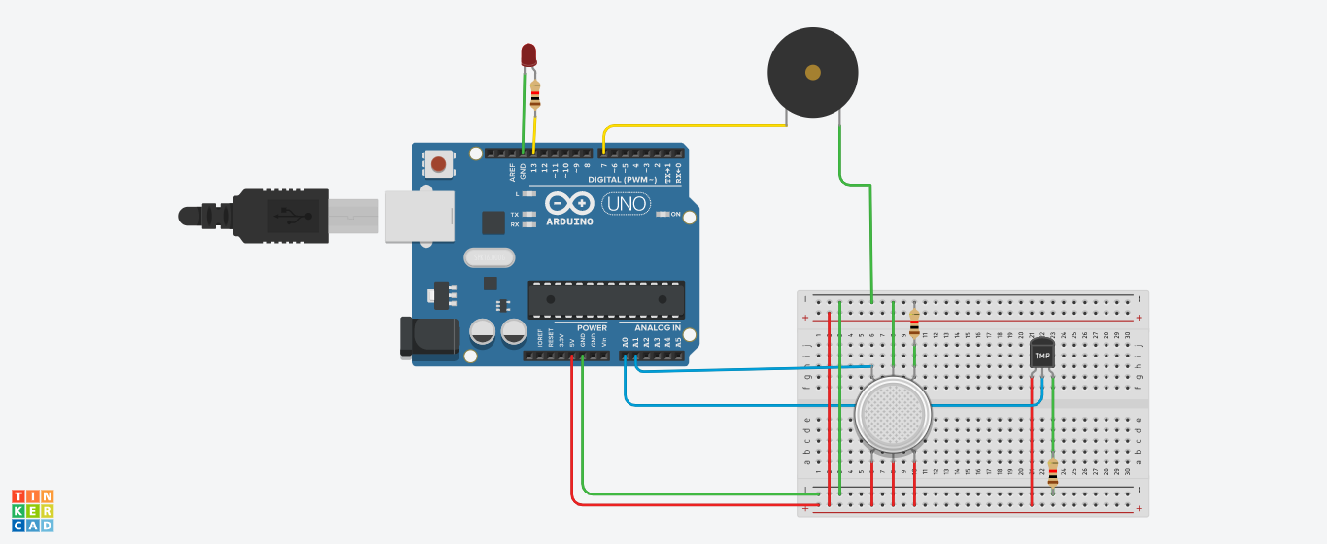
System Design
Circuit Diagram
In the following circuit diagram we can see how the Arduino board is connected to Breadboard for Detection

Slide 8
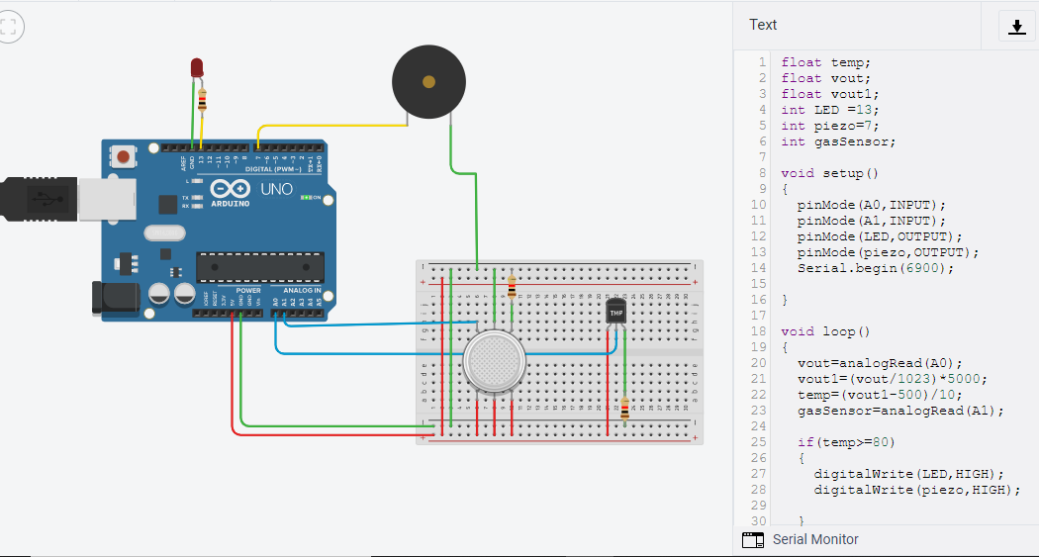
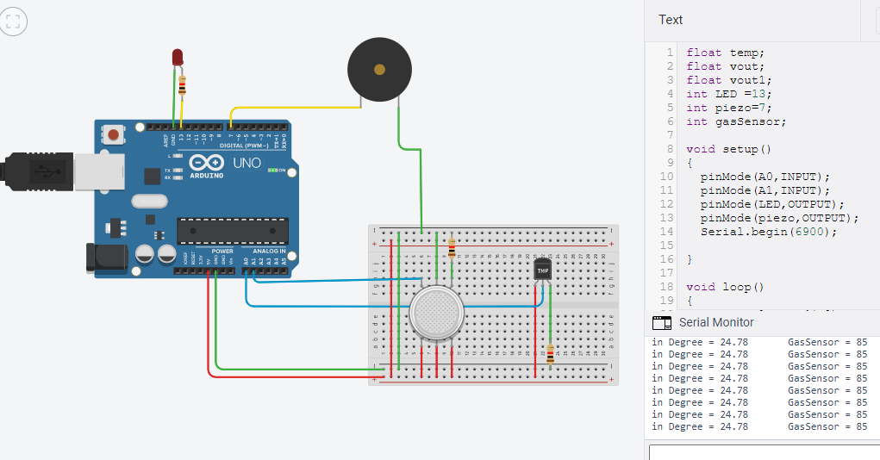
Result & Snapshots
➢ Step 1:
➢Step 2:

Slide 9
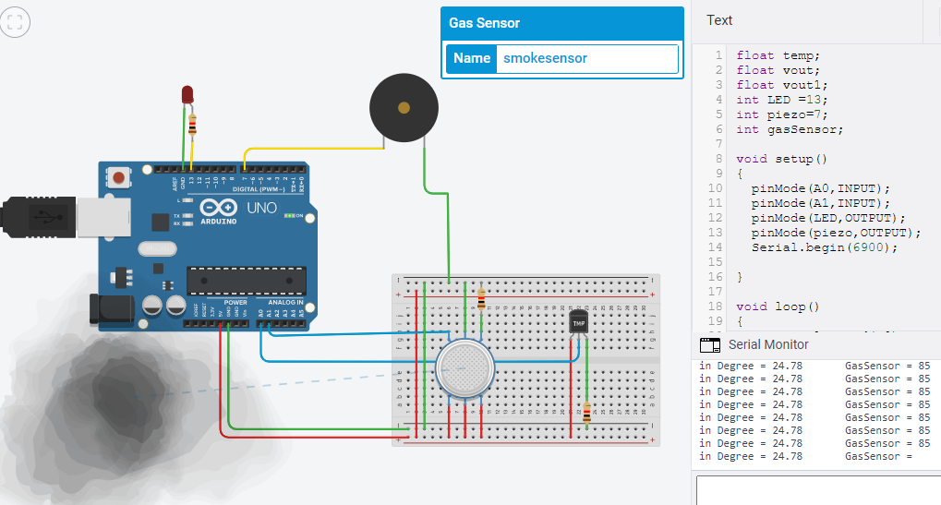
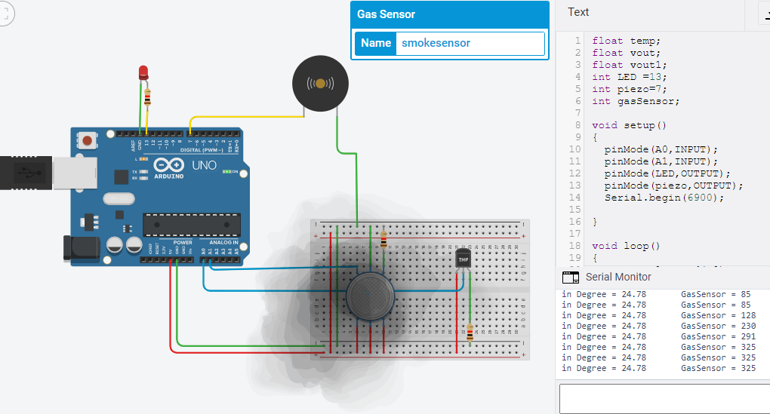
Result & Snapshots
➢Step 3:
➢ Step 4:

Slide 10
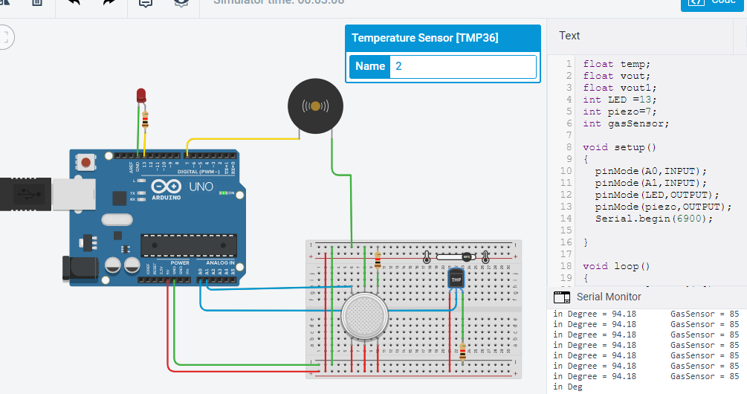
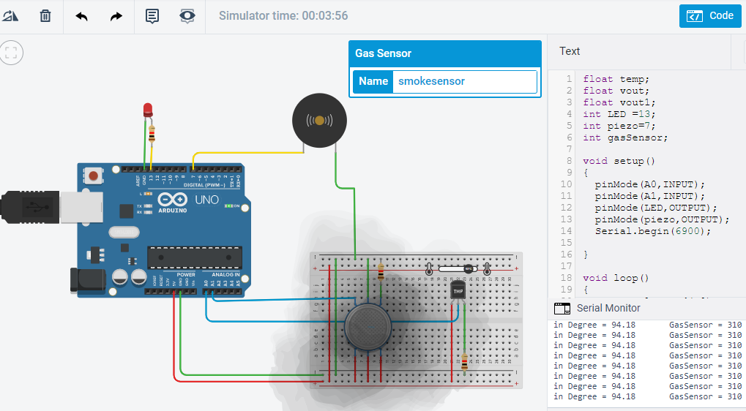
Result & Snapshot
➢ Step 5:
➢ Step 6:

Slide 11
Conclusion
➢ A fire alarm is a device that detects the presence of fire and atmospheric changes relating to smoke. The fire alarm operates to alert people to evaculate a location in which a fire or smoke accumulation is present. When functioning properly, a fire alarm will sound to notify people of an immediate fire emergency. This distinct sound exists to allow the notification to be heard The fire alarm constructed by this project work is reliable at low cost.

Slide 12
Reference
➢ www.wikipedia.com
➢ www.Tinkercad.com
➢www.Google.com

